Slide 1
Reading is Power

Slide 2
Why is Reading Important ?
Reading is important because it can give you knowledge and enjoyment at the same time. For example it you are reading a book about a man who had it all and then suddenly loses it all because he was selfish. You would gain knowledge about life lessons and you will also be into the story because of its intriguing plot. Also reading can help build your vocabulary and writing skills by listening and studying your favorite author. Reading is a venture to your imagination.

Slide 3
MAIN IDEA
Main idea is the most important idea, thought or message of a text.
To find the main idea, you must do the following:
*Find the topic
*What did “what”, “who” do?
*When/Where
*How/Why
*Create Main Idea Statement

Slide 4
PLOT
Plot is sequence of events . In reality it is for the most part a pattern (Plan).
There are parts of the plot that include Exposition, Rising Action, Climax, Falling Action, Resolution/Conclusion.

Slide 5
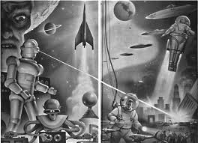
FICTION TEXT
Fiction text is about things that are fake/non-real , they usually cannot happen in real life.

Slide 6
Non-Fiction Text
It is a text that is true, real, authentic. It is usually made to inform the reader.

Slide 7
Complement
Definition: A thing that completes or brings to perfection.
Example: The mouse ran up the clock preposition.
Subject | Predicate
Mouse | Ran
Up is the complement because mouse is the subject and ran is the predicate.

Slide 8
THE END
Thank you for your time. This concludes our powerpoint.

